Slide 1
TASK: 1
PHISHING
AWARENESS

Slide 2
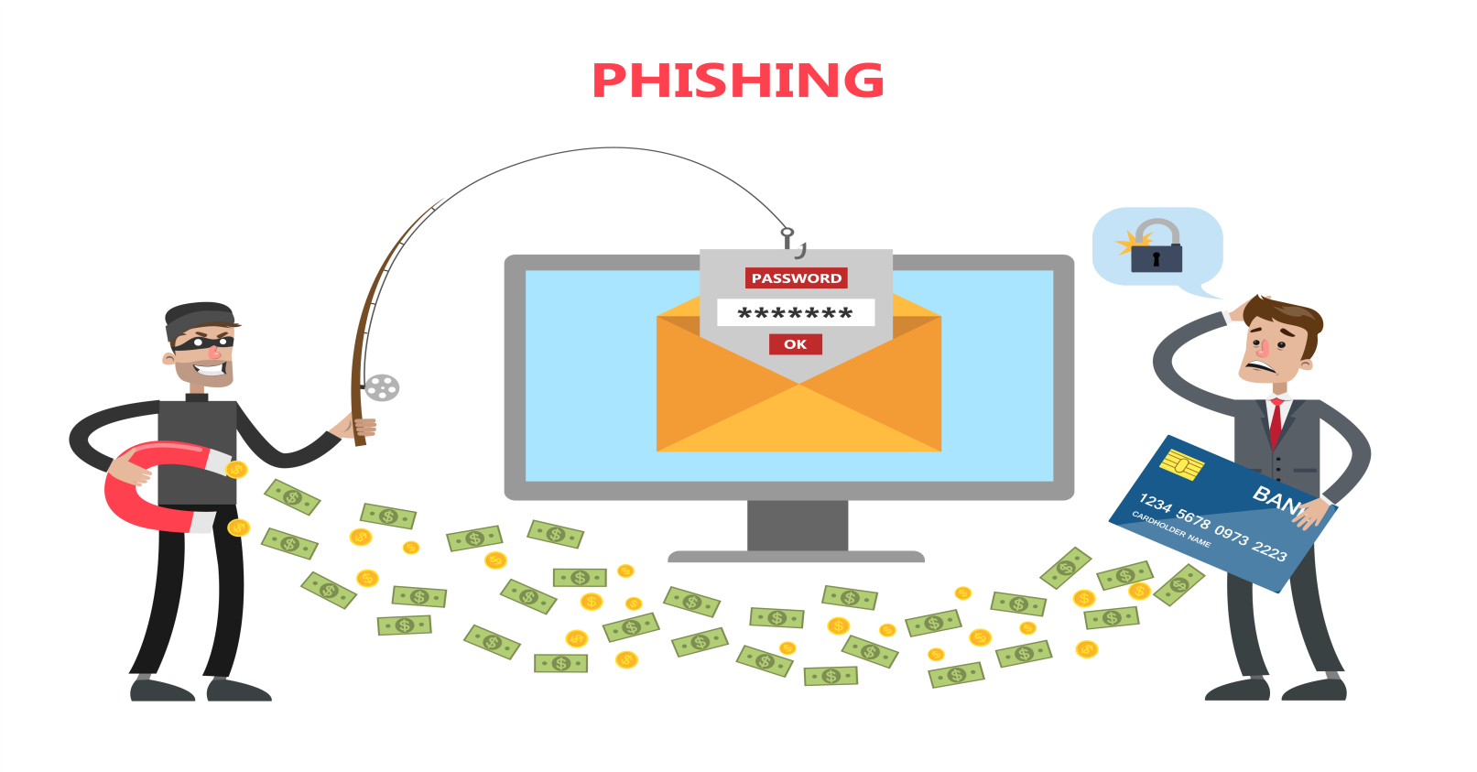
Phishing

Slide 3
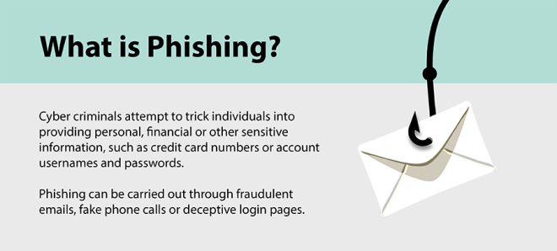

Slide 4
How does phishing work?
The phisher determines the target (whether an organization or individual) and creates strategies to collect data they can use to attack.
Next, the phisher creates fake emails or phony webpages to send messages that lure data from their victims.
Phishers then send messages that appear trustworthy to the victims and begin the attack.
Once they’ve deployed the attack, phishers will monitor and collect the data victims provide on the fake webpages.
Finally, phishers use the collected data to make illegal purchases or commit fraudulent acts such as identity theft.

Slide 5
What is Social engineering?
Social engineering is the act of tricking someone into divulging sensitive information using false trust and persuasion tactics. For example, a scammer may pretend to be a family member in a dangerous situation to get you to quickly send them money.

Slide 6
How to protect yourself from phishing attacks
1) Don’t open suspicious emails:
If you receive an email supposedly from a financial institution with an alarming subject line—such as “Account suspended!” or “Funds on hold”—delete it. If you are worried that there is a problem, log in to your account or contact the bank directly. If there really is a problem with your bank account or credit card, you’ll find information once you’ve logged in.

Slide 7
2) Don’t click on suspicious links in emails:
If you open an email from someone you don’t know and are instructed to click on a link, don’t. Often, these links will take you to fake websites that will then encourage you to either provide personal information or click on links that might install malware on your computer.

Slide 8
3) Don’t send financial information through email:
Your bank or credit card provider will never ask you to provide bank account numbers, your Social Security number, or passwords through email

Slide 9
4)Don’t click on pop-up ads:
Hackers can add fraudulent messages that pop up when you visit even legitimate websites. Oftentimes the pop-ups will warn you that your computer is infected and instruct you to call a phone number or install antivirus protection. Avoid this temptation. Scammers use these ads to either install malware on your computer or scam you out of a payment for a computer cleanup you don’t need.

Slide 10
5)Do use spam filters:
Spam filters can help get rid of spam and phishing emails from illegitimate sources, but you should always use your best judgment in case phishing emails get past your blocker.

Slide 11
6) Do use security software:
By installing security software like Norton 360 Deluxe, you can surf the web with confidence, knowing you took the extra steps to help protect your device from hackers, malware, and other threats of phishing

Slide 12
What to do if you’ve fallen for a phishing scam?
Change your passwords:
Make sure to change the passwords you use for your banking, credit card, and other accounts. Use long and unique passwords and a combination of numbers, letters, and symbols to make these passwords more difficult to crack.

Slide 13
Enable two-factor authentication
(2FA): Consider enabling 2FA if it’s available. 2FA requires entering a second piece of information—such as a code sent to your smartphone—to access an account.

Slide 14
Run antivirus software:
Running antivirus software can help scan your device for any malware that may have infected your computer. Antivirus software can also help you remove malware from your device, ensuring the scammer isn’t spying on your information or harming your device.

Slide 15
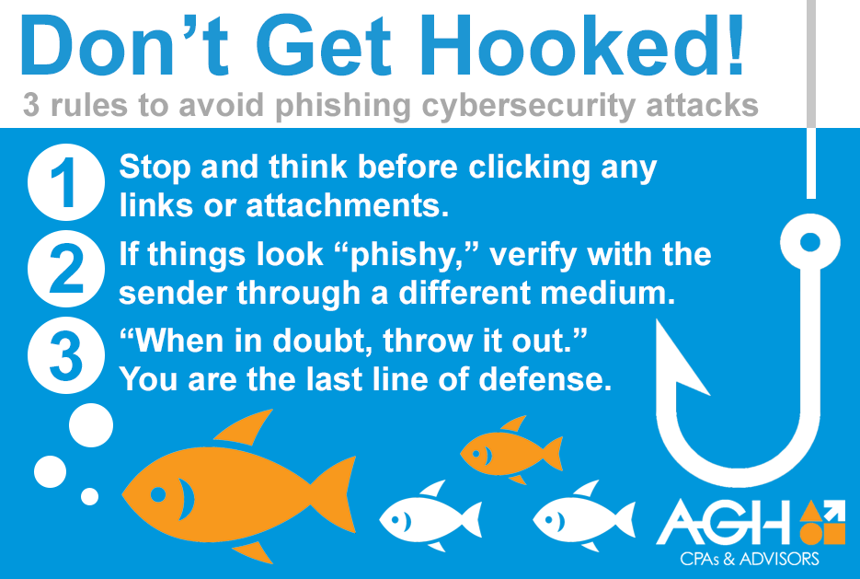

Slide 16
